Slide 1
DIVYA PRIYA S
QR STEGANOGRAPHY
3/21/2024 Annual Review

Slide 2
PROJECT TITLE
QR steganography using python
3/21/2024 Annual Review

Slide 3


AGENDA
1. Introduction to QR code steganography: Explanation of what steganography is and how it can be used to hide information within QR codes.
2. Benefits of QR code steganography: Discussion on the advantages and potential applications of using steganography in QR codes.
3. Tools and software for QR code steganography: Review of popular steganography software and tools available for embedding and extracting hidden information in QR code
4. Best practices for QR code steganography: Guidelines and recommendations for ensuring the security and effectiveness of using steganography in QR codes
5.Conclusion and summary: Recap of key takeaways and insights from the agenda.
3/21/2024 Annual Review

Slide 4

PROBLEM STATEMENT
To develop a Python program that enables hiding confidential data within QR codes using steganography techniques. The program should allow users to embed secret information into QR codes seamlessly, ensuring the integrity of the QR code remains intact. Additionally, it should provide the capability to extract and decode hidden data from QR codes, ensuring secure communication and data transmission.
3/21/2024 Annual Review

Slide 5

PROJECT OVERVIEW
The QR Code Steganography project aims to create a Python-based solution for embedding and extracting hidden data within QR codes. Leveraging steganography techniques, the program encodes confidential information seamlessly into QR codes, maintaining the QR code's visual integrity. Users can securely transmit sensitive data through QR codes while maintaining discretion. The project offers a simple yet effective way to enhance data security and privacy in digital communication.
3/21/2024 Annual Review

Slide 6

WHO ARE THE END USERS?
The end users of the QR code steganography project using Python are
1. Individuals Concerned About Privacy: Individuals who wish to securely transmit sensitive information through QR codes while maintaining privacy.
2. Journalists or Whistleblowers:Professionals who need to communicate confidential information securely, such as journalists working on investigative reports or whistleblowers sharing sensitive information.
3. Businesses and Organizations:Companies and organizations seeking a secure method to exchange confidential data, such as financial information or internal communications.
4. Researchers and Academics:Professionals in academia or research fields who require secure communication channels for sharing sensitive research data or findings.
5. Security Professionals: Security experts or cybersecurity professionals interested in exploring steganography techniques for data protection and secure communication.
3/21/2024 Annual Review

Slide 7

YOUR SOLUTION AND ITS VALUE PROPOSITION
The QR code steganography project using Python provides a discreet and secure method for embedding and extracting hidden data within QR codes. By leveraging steganography techniques, the solution ensures the confidentiality of sensitive information while maintaining the visual integrity of the QR code. With its user-friendly interface and versatility, it caters to a wide range of users, offering enhanced data security and privacy in digital communication.
Value Proposition:
1. Enhanced Data Security:The project employs steganography techniques to conceal sensitive information within QR codes, ensuring that only intended recipients can access the hidden data, thereby minimizing the risk of unauthorized interception or access.
2. Effortless Integration:With its intuitive Python interface, the solution seamlessly integrates into existing workflows, providing users with a straightforward method for encoding and decoding hidden data within QR codes, enhancing data privacy without requiring extensive technical expertise.
3/21/2024 Annual Review

Slide 8
YOUR SOLUTION AND ITS VALUE PROPOSITION
Discretion: By integrating hidden data within QR codes, the project provides a discreet method for transmitting sensitive information, reducing the risk of interception or detection by unintended recipients.
Ease of Use: With a user-friendly Python interface, the solution offers simplicity and accessibility, allowing users to encode and decode hidden data within QR codes with minimal effort.
Versatility: The project's flexibility enables it to be adapted for various use cases, including personal communication, business transactions, research collaboration, and more, catering to a diverse range of user needs.
3/21/2024 Annual Review

Slide 9

THE WOW IN YOUR SOLUTION
The "wow" factor in this solution lies in its ability to seamlessly blend advanced data security techniques with everyday technology. By harnessing the power of steganography within QR codes, the solution offers a visually unassuming yet highly effective method for safeguarding sensitive information. Users are empowered to transmit confidential data with ease, utilizing familiar QR code technology while benefitting from enhanced privacy and security measures, ultimately eliciting surprise and admiration for its innovative approach to digital communication security.
3/21/2024 Annual Review

Slide 10
MODELLING
Modeling QR code steganography involves designing a system that can efficiently encode and decode hidden data within QR codes while maintaining their visual integrity. Here's a high-level overview of how you could model this process:
1. QR Code Generation:
- Develop a module to generate QR codes using a library like `qrcode` in Python.
- Allow users to input the data they want to encode into the QR code.
2. Steganography Encoding:
- Implement steganography techniques to embed the user's data into the generated QR code.
- Choose a suitable method for hiding the data within the QR code, such as LSB (Least Significant Bit) substitution or modifying specific areas of the QR code.
3. QR Code Decoding:
- Create a decoder module to extract hidden data from QR codes.
- Implement algorithms to reverse the steganography process and retrieve the encoded information.
4. Testing and Validation:
- Test the encoding and decoding processes with various types of data and QR codes to ensure accuracy and reliability.
- Validate the integrity of the hidden data to ensure that it can be successfully retrieved without errors.
3/21/2024 Annual Review

Slide 11
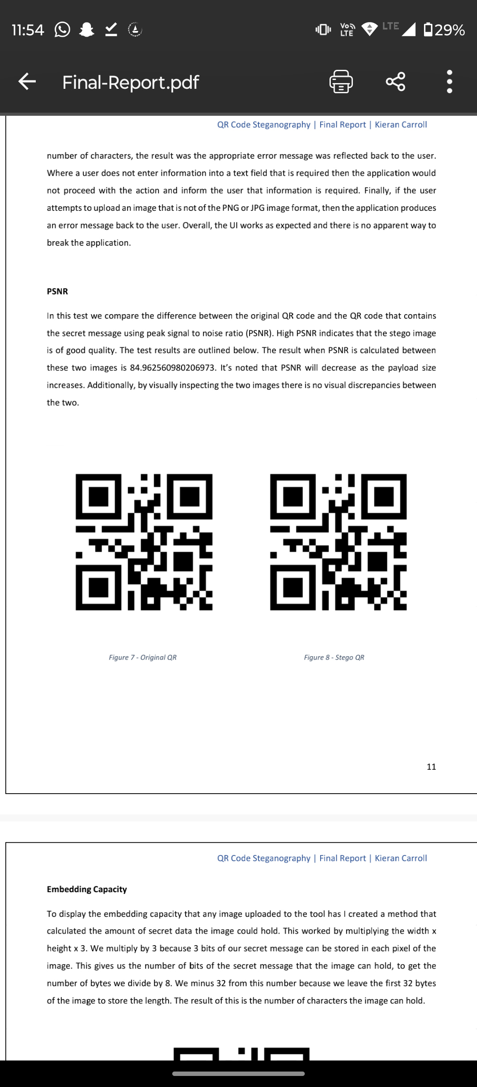
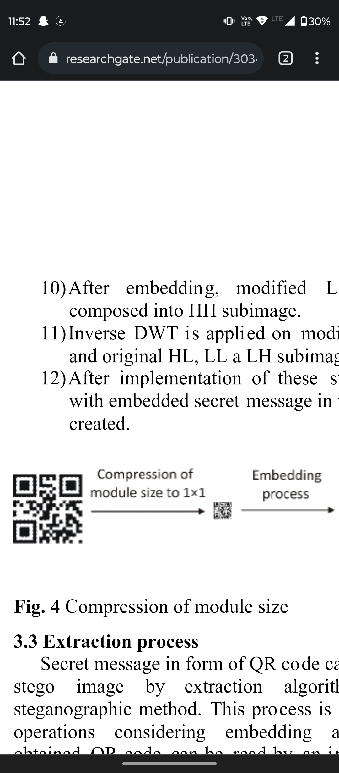
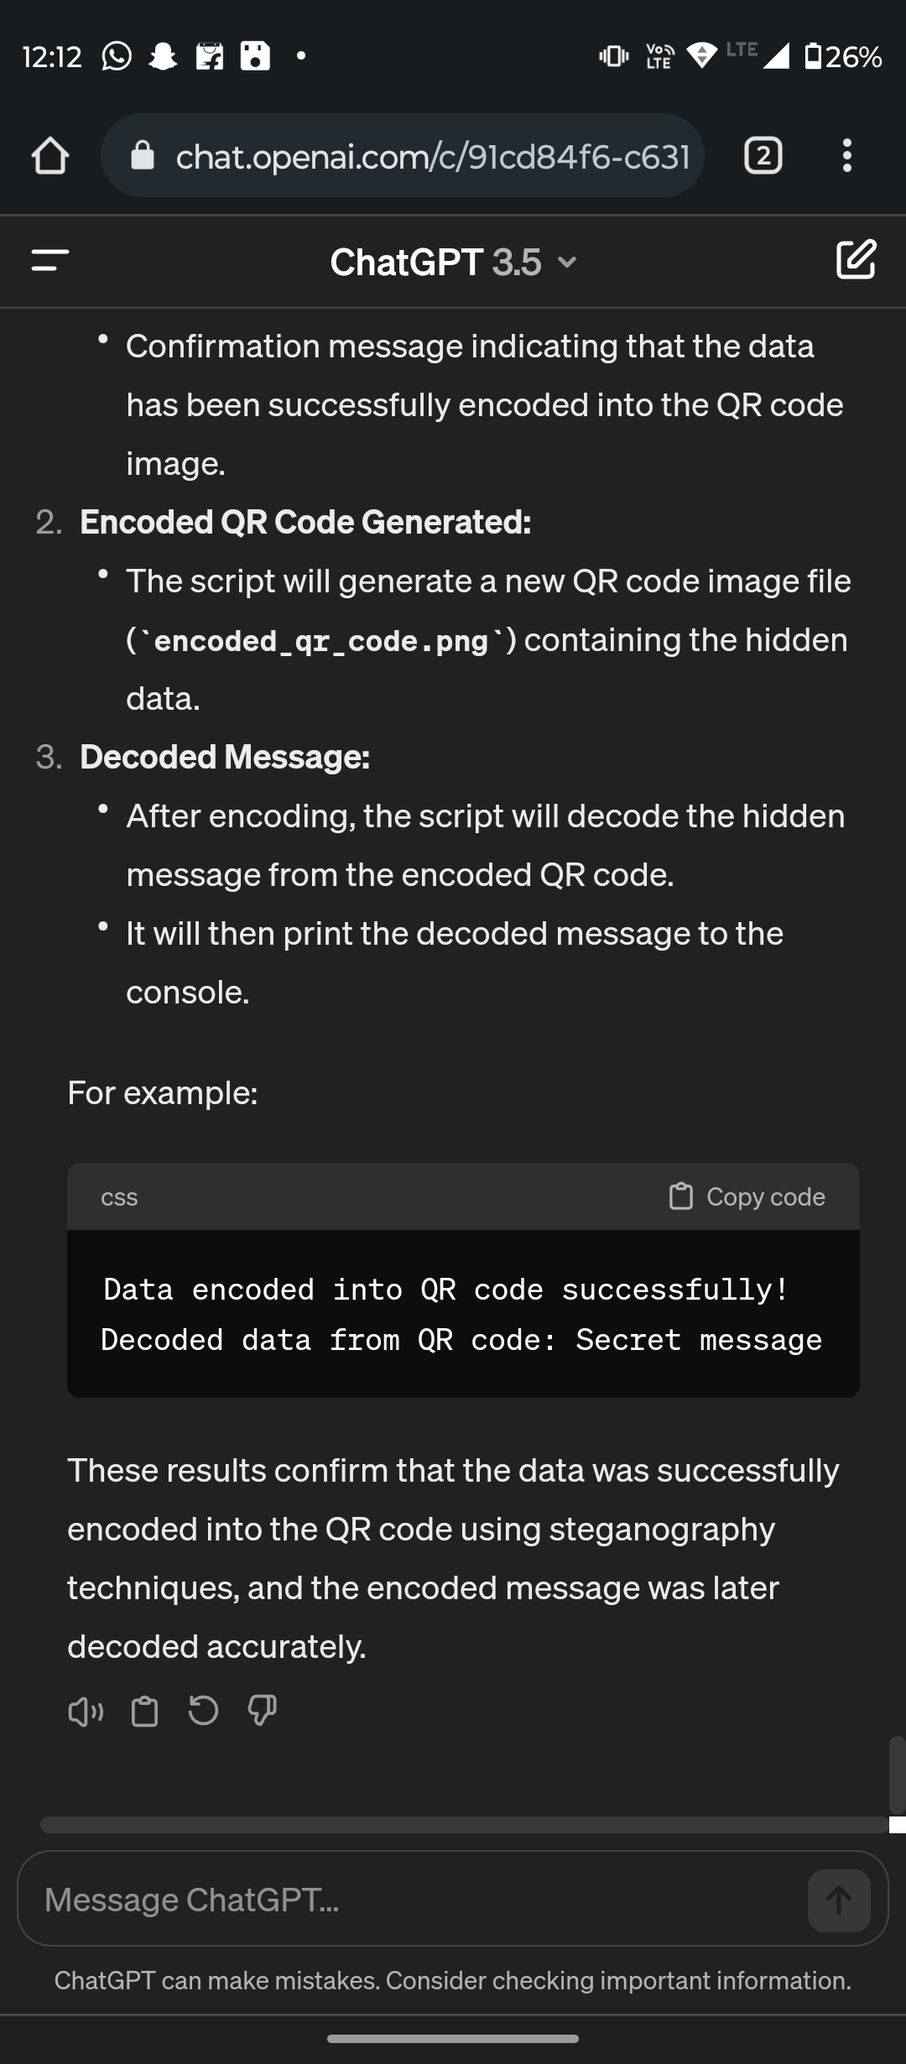
MODELLING
Original QR
Stego QR
3/21/2024 Annual Review

Slide 12
RESULTS
Here are the expected results for the QR code steganography encryption:
1. Data Encoded Successfully:
- Confirmation message indicating that the data has been successfully encoded into the QR code image.
2. Encoded QR Code Generated:
- The script will generate a new QR code image file (`encoded_qr_code.png`) containing the hidden data.
3. Decoded Message:
- After encoding, the script will decode the hidden message from the encoded QR code.
- It will then print the decoded message to the console.
For example:
Data encoded into QR code successfully!
Decoded data from QR code: Secret message
Demo Link
3/21/2024 Annual Review

